Slide 1
Writing Consciousness
POETRY IN THE AGE OF BIOMEDICINE
Anishta Khan

Slide 2
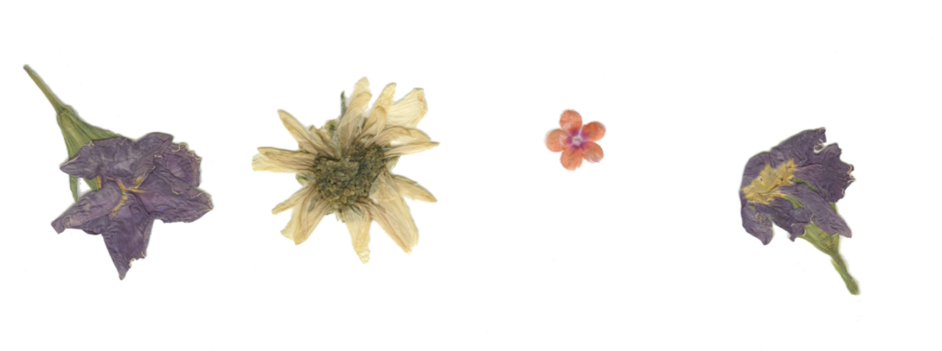
“We come to poetry, I think, because we are silenced in many ways. In biomedicine, we’re so good at appropriating the narrative—the biopsy report, the CT count, the potassium level. Writing gives patients an opportunity to say, this is my cancer, this is my HIV. It’s not a generic, what you see on the mammogram or how many lymph nodes are positive—I’m an individual.”
RAFAEL CAMPO, POET-PHYSICIAN

Slide 3
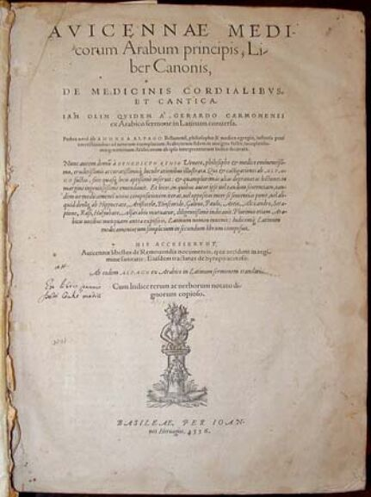
Historical Roots
Apollo, dual god of medicine and poetry ~~
therapy stems from the Greek word, therapeia, meaning to cure through dance, song, poetry and drama, c. 401
psychology: psyche meaning soul and logos speech or word
Avicenna, Persian polymath, author of The Cannon of Medicine, wrote in poetic verses, c. 1037
"Native people see painting as indistinct from dancing, dancing as indistinct from worship, and worship as indistinct from living"

Slide 4
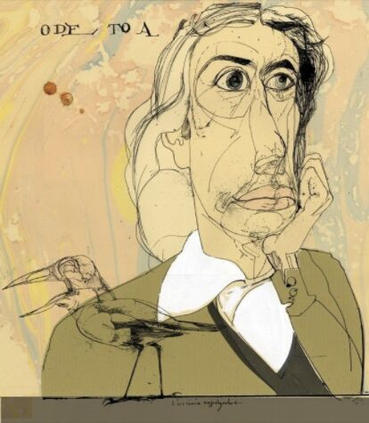
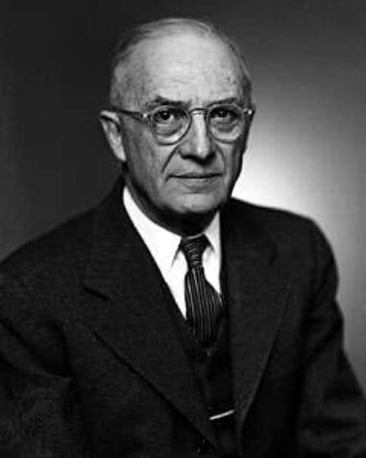
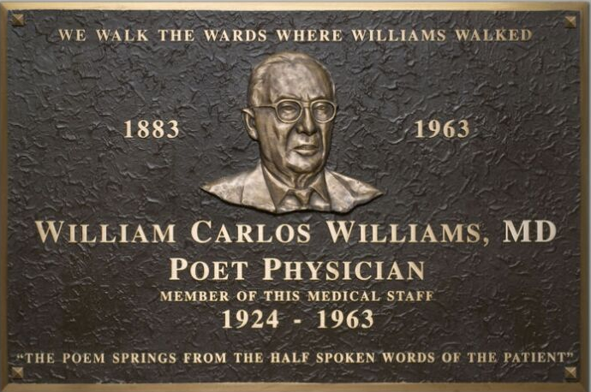
Early Poet
Physicians
John Keats: English Romantic, Apothecarist and Surgeon at Guy's Hospital, c. 1795
William Carlos Williams: Imagist and Modernist, Chief of Pediatrics at Passaic General Hospital, c. 1924

Slide 5
Poetry in Medicine Today

Slide 6
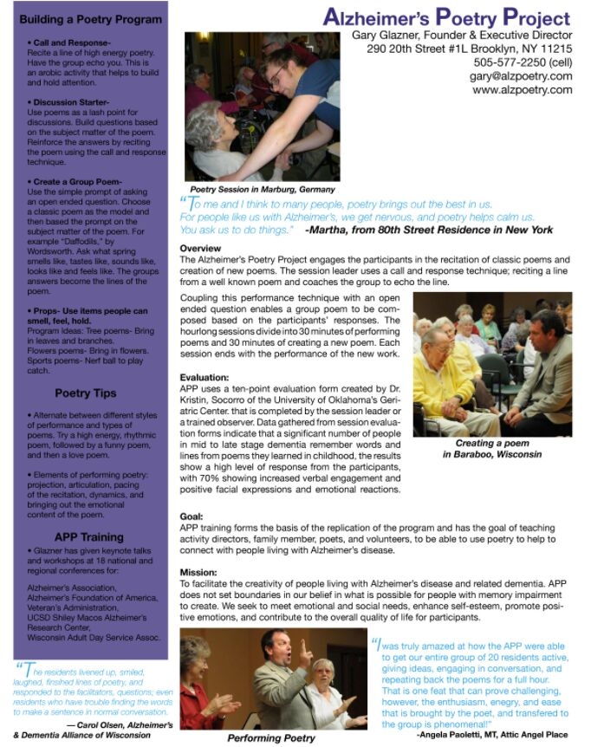
Poetry Therapy, as a practice
Poetry Therapy is the language oriented branch of expressive arts therapy.
The International Federation for Biblio/Poetry Therapy (IFB/PT) is the independent credentialing authority for the profession of poetry therapy.

Slide 7
Poetry Therapies
"Poetry is of our bodies in a way that almost no other art form is. This notion that poetry is elitist or “I can’t understand it” — it’s false. There is so much in poetry that is gripping and compelling and expresses in a fundamental and visceral way what it is to be human." - R.C.
First method: therapist selects a poem that highlights a problem that the patient group is dealing with to facilitate dialogue
A second method of therapy calls on patients to write their own poems as a window to the psychology of the poet
A third potential benefit of writing poetry: Catharsis - writing a poem can help to clear up one's emotions on a complex issue

Slide 8
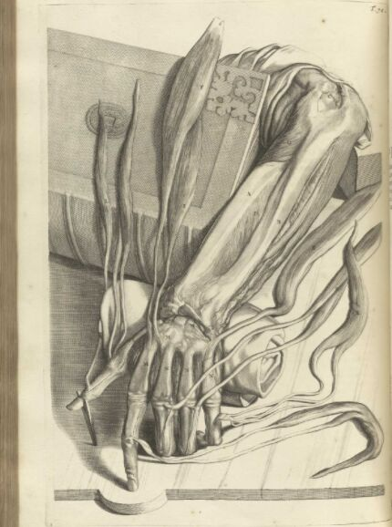
Healing in Poetry
At the deathbed: “In a way, [the patient] achieved something that medicine still hasn’t figured out: a kind of immortality. He’s alive in those poems and stories; he’s present in those stories, really, forever.” - R.C.
Yale Psychiatrist Albert Rothenberg offered that "poetry by itself does not cure," but noted the benefit of its unique focus on verbalization, which, he offered, is "the lifeblood of psychotherapy."
I felt I lost my edge
and then I lost my place
but the tragedy is
I have so much to say.
PATIENT WITH BRAIN CANCER, DEPT. OF NEURO-ONCOLOGY, UCLA

Slide 9
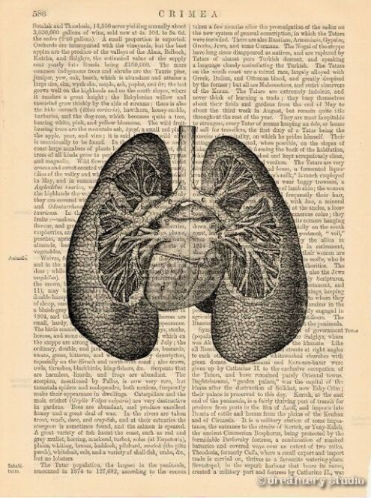
Poetry in Healing
Disrupt the doctor–patient hierarchy, observer-participant relationships
Practices of witnessing, empathy and listening emerge in writing
Illness narratives not only recount and interpret symptoms but also describe illness as an event that reflects wider cultural contexts, including race, gender, class, and sexuality
"Poetry communicates at the subconscious level, which is why some lines move us to tears or lift us in joy, inspire us or save us from destroying ourselves"

Slide 10
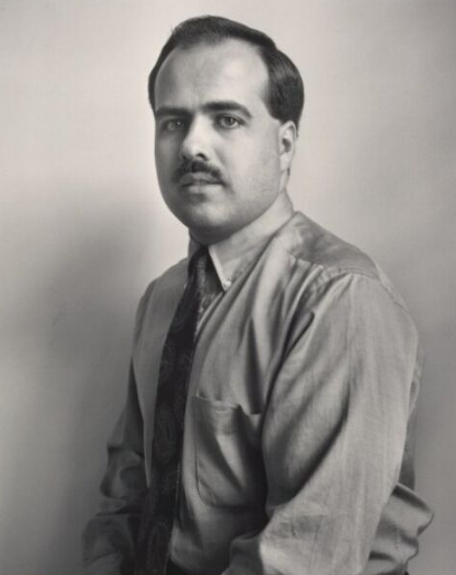
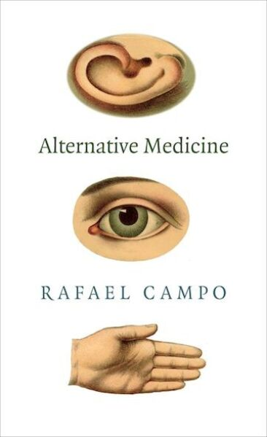
Rafael Campo
Rafael Campo is a poet and essayist who teaches and practices internal medicine at Harvard Medical School and Beth Israel Deaconess Medical Center in Boston. Has published several collections of poetry and essays, and has won numerous awards including a Guggenheim fellowship. He currently also serves as the editor for the Poetry and Medicine section in JAMA..
Morbidity and Mortality Rounds
from The Changing Face of AIDS: V. Elegy for the AIDS Virus
What the Body Told

Slide 11
Sources:
https://www.poets.org/poetsorg/text/poetry-and-medicine-rafael-campo-conversation
https://www.bostonglobe.com/metro/2018/12/30/obliged-listen-how-poetry-elevates-doctor-work/kitczqlG9xsRAF9yJZuITI/story.html:
https://journals.sagepub.com/doi/pdf/10.1177/1471301214560378
https://www.ncbi.nlm.nih.gov/pmc/articles/PMC2902099/
https://medium.com/@bijalashah/why-poetry-is-one-of-the-most-powerful-forms-of-therapy-f3553cb909b4
https://www.huffpost.com/entry/can-poetry-heal_n_145560?ref=tw
https://link.springer.com/article/10.1007/BF03391268
http://www3.brandonu.ca/cjns/10.1/dufrene.pdf
https://www.bl.uk/romantics-and-victorians/articles/john-keats-poet-physician
Treatments by Lisa Diedrich
Poetry Therapy: Theory and Practice by Nicholas Mazza

